Slide 1
An Agent-Based Computational Framework for
Distributed Data Analysis
To appear in IEEE COMPUTER in later winter/early spring 2020
Munehiro Fukuda, Ph.D.
Computing & Software Systems University of Washington Bothell

Slide 2
Outline
Background
“Big-Data computing” softwire
  Data collective - MPI
  Data Stream - Hadoop, Spark and Storm
  Data Hunting - IBM Aglets, D’Agents, JADE
  Data Discovery - MASS
Multi-Agent Spatial Simulation(MASS)
  Features for Distributed Data Sciences
  Data Analysis Patterns Using Agents
  Pragrammability Analysis and Executioin Performance
Student Projects

Slide 3
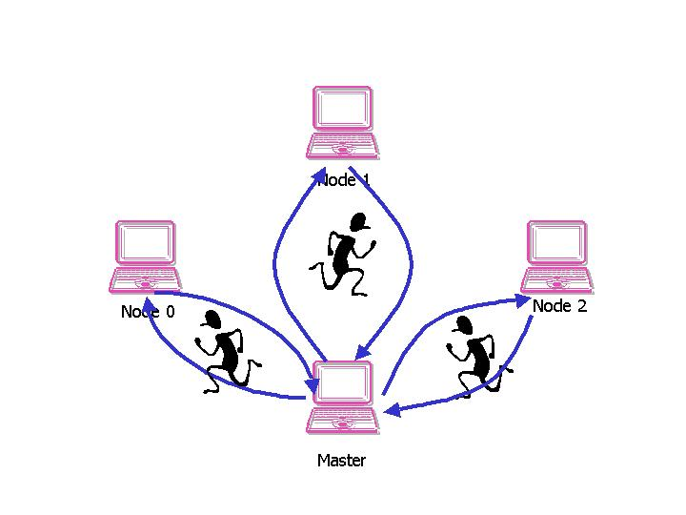
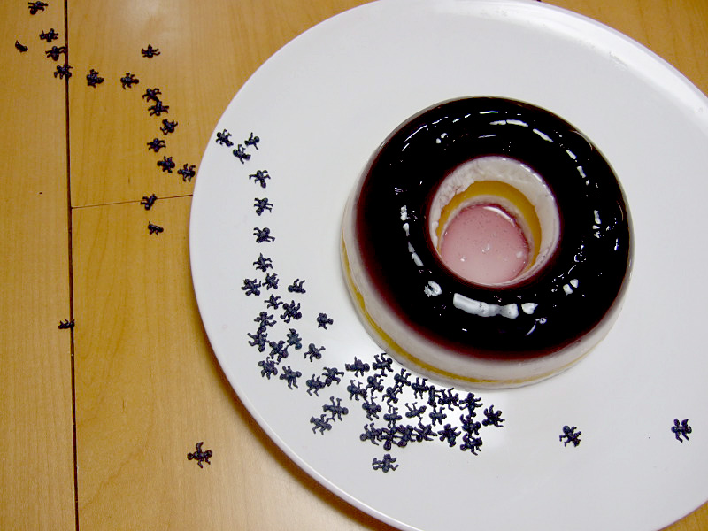
Background
- What is Software Agents
Cognitive Agents
Reactive Agents
coarse-grain execution entities that achieve network-administrative and computation-intensive task, based on their behavioral intelligence
  fine-grain entities, each reacting to its environment with simple rules.
Our focus

Slide 4
Data collective - MPI
Nov 13th, 2019
mpi
run
mpdboot
-n 4
sshd
sshd
sshd
mpd.hosts
uw1-320-20
uw1-320-21
uw1-320-22
uw1-320-23
mpd
mpd
mpd
mpd
broadcast/scatter
.mpd.conf
reduce/gather
secretword=…
user
process
user
process
user
process
user
process
rank 0
rank 1
rank 2
rank 3
CPU
CPU
CPU
CPU
Memory
Memory
Memory
Memory
NIC
NIC
NIC
NIC
uw1-320-00
uw1-320-01
uw1-320-00
uw1-320-03
LAN / SAN

Slide 5

Data Streaming
- Hadoop, Spark and Storm
Nov 13th, 2019
Hadoop Spark
Storm
Streaming data to parallel analyzers
inputs
inputs
shuffle
Fields on “word”
S
B1
B2
Map
RDD1
S
B1
B2
Reducing partial results to the main program
B1
Temp
Transformation
All
RDD1
Reducing partial results to the main program
Reduce
Streaming data to parallel analyzers
B3
Action
B3
results
RDD1

Slide 6


Data Hunting
- Mobile Agents: IBM Aglets, D’Agents, etc.
Nov 13th, 2019
          Use agents mobility to hunt remote data.
          Reduce the number of RPCs and to lower memory-access latency
Node 1
Node 2
Node 3
Master Node

Slide 7
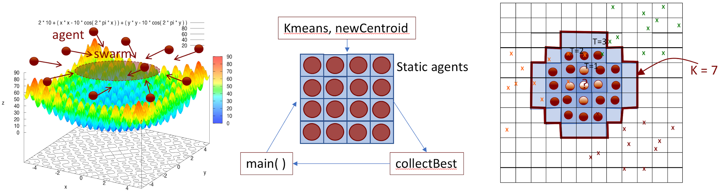
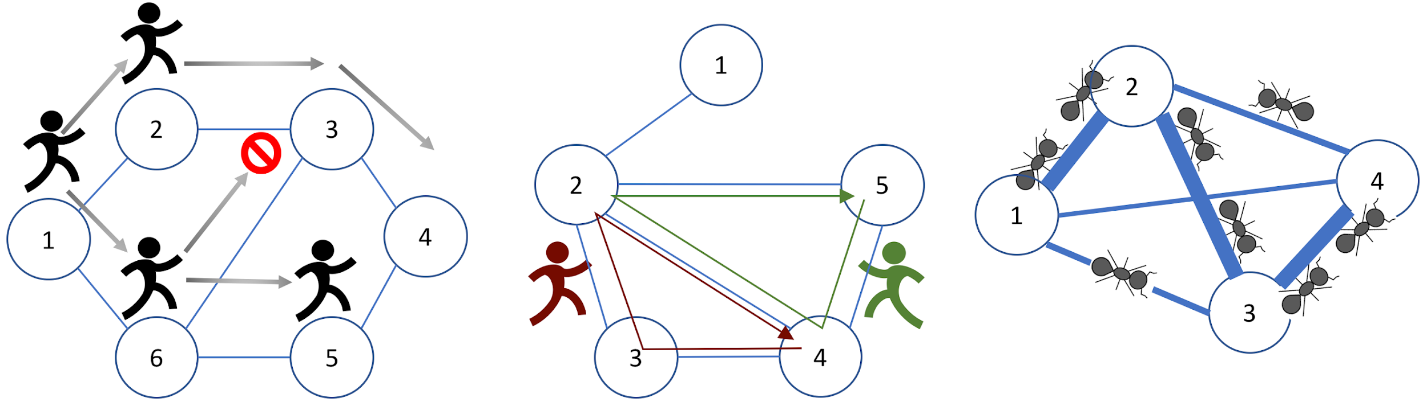
Data Discovery
- Agent-Based Model
Nov 13th, 2019
Recall
Biologically-inspired algorithms
Ant Colonial Optimization
Particle Swarm Optimization
Node 1
Big Data
Node 2
Node 3
Node 4

Slide 8
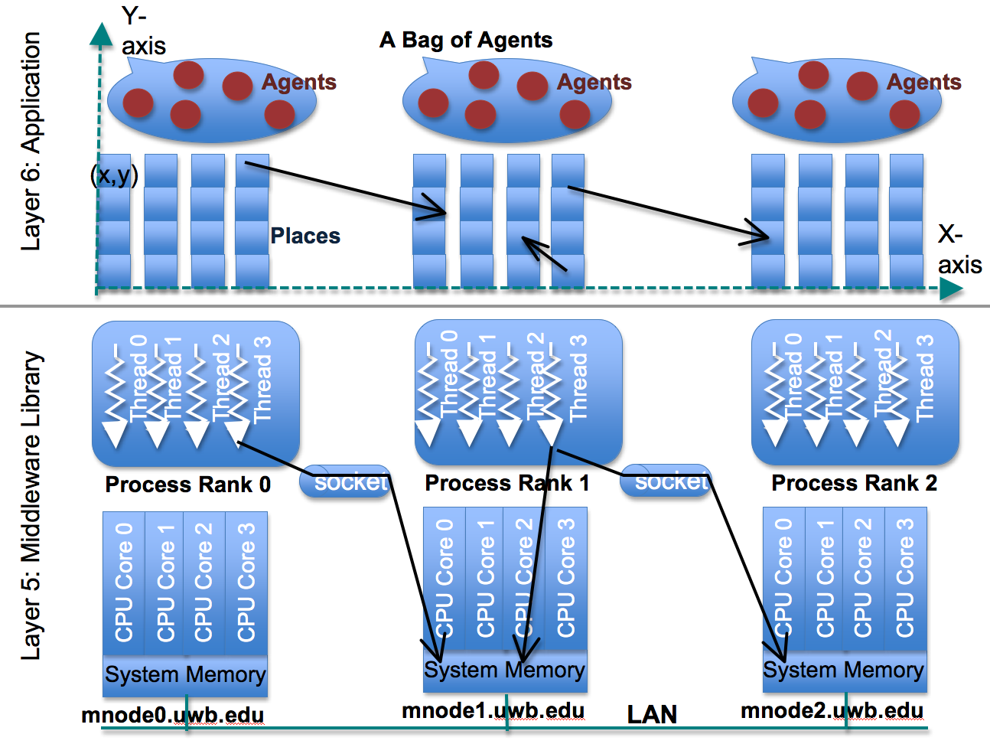
Multi-Agent Spatial Simulation

Slide 9
MASS Specification
Public static void main( String[ ] args ) {
  MASS.init( args );
  Places space = new Places( handle, “MySpace”, params, xSize, ySize);
  Agents agents = new Agents( handle, “MyAgents”, params, space, population );
  space.callAll( MySpace.func1, params );
  space.exchangeAll( MySpace.func2, neighbors );
  agents.exchangeAll( MyAgents.func3 );
  agents.manageAll( );
  MASS.finish( );
}
func1( )
func1( )
func1( )
func1( )
func2( )
func1( )
…
…
func2( )
func2( )
func3( )
func2( )
func3( )

Slide 10
Applying MASS to Structured Data Analysis
Our simulation work:
Agent-based modeling
Our new work:
Agent-based data discovery
Simulating an emergent collective group behavior of agents
  Example:
  Traffic simulation
  Epidemic simulation
Analyzing structured data through an emergent grou behavior of agents
  Example:
  Network problems – triangle counting and BFS-based shortest path
  Biologically inspired optimization – ACO-based traveling sales person problem and PSO
  Data clustering and classificaiton – KMeans and KNN

Slide 11
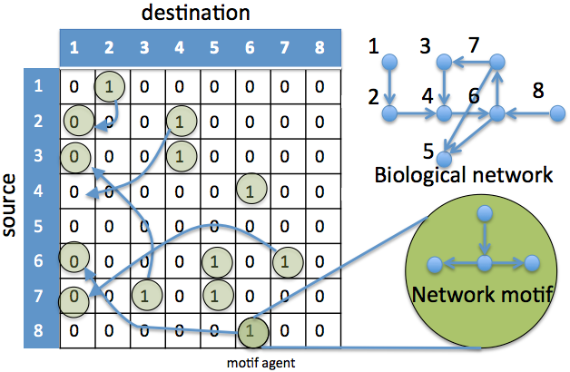
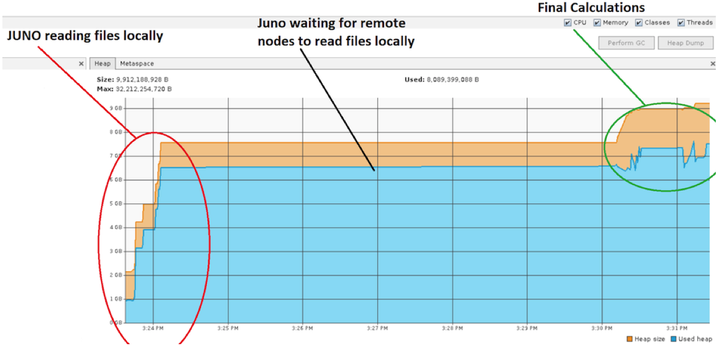
Preliminary Work on Data Analysis
Nov 13th, 2019
Climate Change Analysis
Biological Network Motif Search
With Prof. Eric Salathe
With Prof. Wooyoung Kim

Slide 12
Experiences from Preliminary Work
Nov 13th, 2019
Problems
Improvements Needed
MASS spawned 5.5 million agents in total.
They all moves at once.
The master node became a bottleneck of file I/Os.
Agent population control
Asynchronous migration
Parallel file I/O.

Slide 13
Asynchronous agent migration
Nov 13th, 2019
Typical ABM simulation update the state of all agents synchronously with its logical time.
Overhead !
No need to be Synchronous
doAll(ﬁd[],iterations)
Automates asynchronous iterations of callAll(ﬁd) and manageAll() invocations.

Slide 14
Agent population control,
Nov 13th, 2019
Specify the max size of agent population in MASS.Init(size)
Whenever population reaches size, new children are deactivated and serialized.
When population of active agents is below size, the inactive children will be deserialized and allowed to execute.
A
A
R
A
R
R
R
R
A
agent
R
spawn request

Slide 15
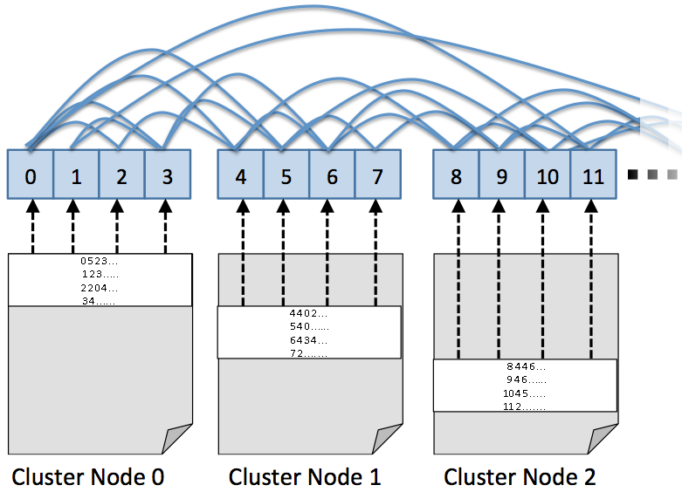
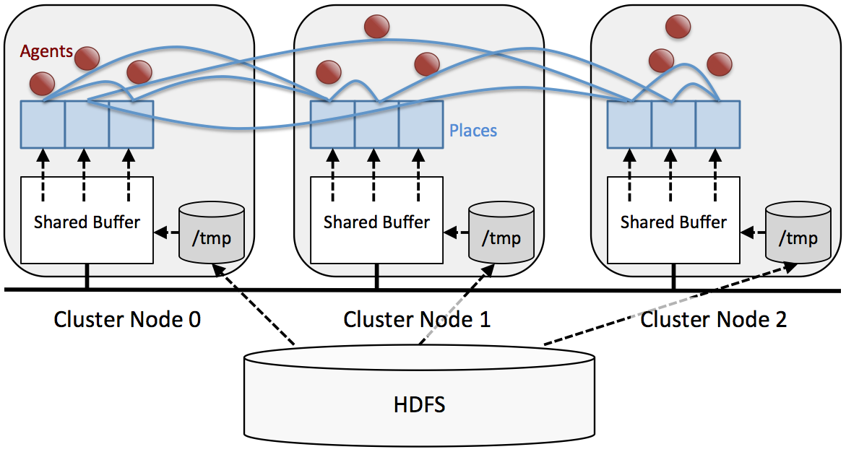
Parallel file I/O.
Nov 13th, 2019
CSV File
Src, Dst1, Dst2, Dst3, Dst4, …
0, 5, 2, 3
1, 2, 3
3, 4

Slide 16
Comparing Revised MASS with Spark and MapReduce
Coded and ran 6 benchmark programs with each of MASS, Spark, and MapReduce
  Graph problems
    Triangle Counting
    Breadth First Search
    ACO-based TSP
  Multi-dimensional arrays
    PSC (Particle Swarm Optimizaiton) over a 2D space
  Data clustering and classification
    KMeans
    KNN

Slide 17

Data Analysis Patterns Using Agents
Graph Analysis : Triangle Counting
Data streaming
Data Discovery
Analytics stay passive to receive data.
  All data must be examined.
  Data must be flattend to feed.
Analytics actively move over data.
  Only necessary portion of data can be examined.
  Data can maintain its structure.
  Code is written from the driver’s viewpoint.
  (1,2), (2,1), (2,3), (3,2), (2,4), (4,2), (2,5), (5,2), (3,4), (4,3), (4,5), (5,4)
  (1, [2]), (2, [1,3,4,5]), (3, [2,4]), (4, [2,3,5]), (5, [2,4])
1
  [(1,2), -], [(1,3), 2], [(2,3), -], [(2,3), 4], [(2,4), -], [(2,4),3],
  [(2,4), 5], [(2,5), 4], …
2
5
  (2,3) [-,4] 🡪 (2,3,4), (2,4) [-,3,5] -> (2,4,3), (2,4,5)…
  (2,3,4), (2,3,4), (2,3,4), (2,4,5), (2,4,5)..
  (2,3,4), (2,4,5)
3
4

Slide 18
Data Analysis Patterns Using Agents
Graph Analysis : Triangle Counting
Data streaming
Data Discovery
public class MyAgent extends Agent {
private int hopCounts = 0, source = −1;
public Object onArrival(Object arg) {
if (++hopCounts == 1) source=place.index;
if (hopCounts < 3)
spawn(chooseLowerIDs(place.neighbors));
else
next = source; // go back to the source.
}
}
Analytics stay passive to receive data.
  All data must be examined.
  Data must be flattend to feed.
  (1,2), (2,1), (2,3), (3,2), (2,4), (4,2), (2,5), (5,2), (3,4), (4,3), (4,5), (5,4)
  (1, [2]), (2, [1,3,4,5]), (3, [2,4]), (4, [2,3,5]), (5, [2,4])
1
  [(1,2), -], [(1,3), 2], [(2,3), -], [(2,3), 4], [(2,4), -], [(2,4),3],
  [(2,4), 5], [(2,5), 4], …
  (2,3) [-,4] 🡪 (2,3,4), (2,4) [-,3,5] -> (2,4,3), (2,4,5)…
2
5
  (2,3,4), (2,3,4), (2,3,4), (2,4,5), (2,4,5)..
  (2,3,4), (2,4,5)
3
4

Slide 19
Data Analysis Patterns Using Agents
- Graph Analysis : BFS & ACO- based TSP
Nov 13th, 2019
BFS
Ant Colonial Optimization based
travelling salesperson problem (ACO- based TSP)
public class MyAgent extends Agent {
public Object onArrival(Object arg) {
if (place.visited) kill();
spawn(place.neighbors);
}
public Object onDeparture(Object arg) {
migrate(next);
}
}
Agent (Ant) are randomly populated over a graph.
Move from one city to another according to route distance and pheromone amount.
Travels again adding pheromone contribution of each link.
More ants travel the same path as the pheromone increases. That reveals the approximate shortest path.

Slide 20
Data Analysis Patterns Using Agents
Multi-Dimensional Data Analysis
Nov 13th, 2019
public class MyAgent extends Agent {
int[] bestAgentGlobally,bestAgentPrivately;
public Object onArrival(Object bestAgent) {
bestAgentGlobally = (int[])bestAgent;
bestAgentPrivately = {findex[0], index[1], place.valueg;}
return (bestAgentPrivately[2]<bestGlobally[2])?
bestAgentPrivately : bestAgentGlobally;
}
public Object onDeparture(Object bestAgent){
x = place.index[0] + updateVelocity((int[])bestAgent);
y = place.index[1] + updateVelocity((int[])bestAgent);
migrate(x, y);
}
}

Slide 21
Data Analysis Patterns Using Agents
- Data Clustering and Classiﬁcation
Nov 13th, 2019
K Means
KNN
Generate a clustering representation for a given dataset by places and agents.
Places and agents send results back to the main program to be processed.
Advantage: Paralleling running KMeans multiple.
Drawback: Dataset must fit in the memory of places and agents.
An agent is spawned at the user indicated position and creates new agents until finds K training data.
Then the agent uses a majority vote method for classification.
for(int i = 0; i < placesSize; i++){
space.callAll(Space.detect );
space.callAll(Space.propogate );
reporters.callAll(Reporter.spawnChild );
reporters.manageAll();
if (reporters.nAgents() >= 2 ∗ k)
break; //a rough circle
}

Slide 22
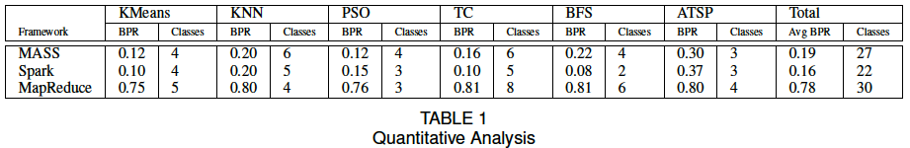
Programmability
Data Management
  Texts are better handled with data streaming in MapReduce and Spark.
  MASS can construct structured data in memory using parallel I/O.
A Chain of Data-Rambling Jobs
  Spark provides a greater variety of different map-and-reduce function types than key-value pairs in MapReduce.
Qualitative Analysis
  Spark lowest of classes:
  can combine multiple classes into one RDD.
  MASS stays consistent with an average of 5 classes :
  3 required classes and one or two utility classes to help package data.
  MapReduce highest boilerplate ratio :
  Due to the large amount of information that must be conveyed to HDFS.

Slide 23
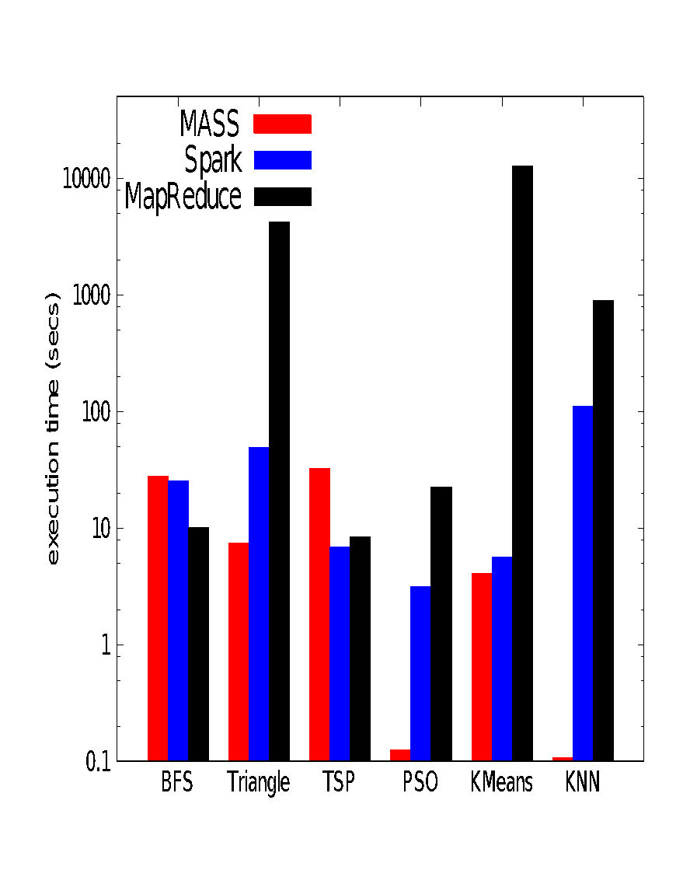
Executions Performance
- Single Node Executions (MASS vs Spark/MapR)

Slide 24
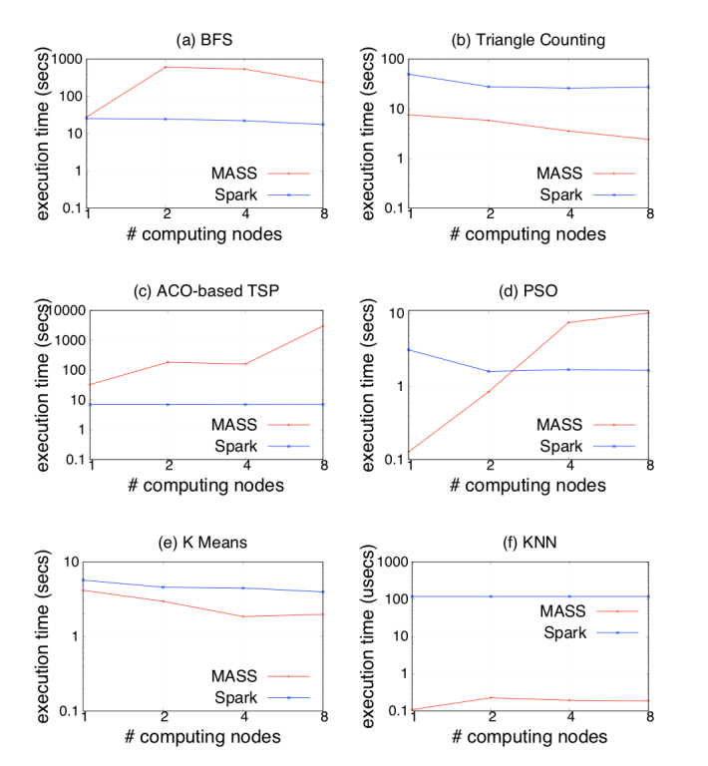
Executions Performance
- Parallel-executions (MASS vs Spark)
Nov 13th, 2019
Spark performed better than MASS in BFS and TSP, but its CPU scalability could not outperform MASS in TC, KMeans, and KNN.
MASS reads data in places directly from each computing node’s /tmp,
Spark creates an RDD in main(). Then distributed to the other cluster nodes.
➔ overhead.

Slide 25
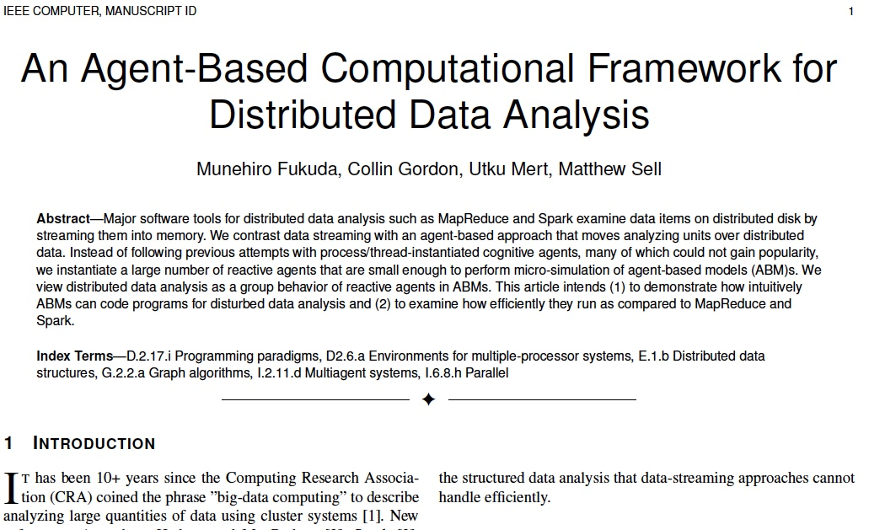
Remarks
Our benchmark tests implied each platform’s different strength in data analysis, rather than identified one as the best all-around tool.
Look for our names in IEEE Computer!
MASS | Spark / MapReduce
Constructing data structures in memory | Streaming plain data through memory
Good at navigating agents over numerical data | Good at alpha-numerical mix data points

Slide 26
Past Student Research Outcome
(gradudate students in red and undergraduate students in blue, listed below)
Lisa Kosiachenko, Nathaniel Hart, Munehiro Fukuda, MASS CUDA: A General GPU Parallelization Framework for Agent-Based Models, In Proc. Of PAAMS, Avila, Spain, pages 139-152, June, 2019
Yun-Ming Shih, Collin Gordon, Munehiro Fukuda, Jasper van de Ven, Christian Frekas, Translation of String-and-Pin-Based Shortest Path Construction into Data-Scalable Agent-Based Computational Models, WSC 2018, Gothemburg, Sweden, December 10-13 2018
Craig Shih, Caleb Yang, Munehiro Fukuda, Benchmarking the Agent Descriptivity of Multi-Agent Simulators, In Proc. of PAAMS/MAS&S, Toledo, Spain, June 20-22, 2018
Collin Gordon, Munehiro Fukuda, Demonstration of Agent-Based Clustering and Classification Algorithms, In Proc. of PAAMS/MAS&S, Toledo, Spain, June 20-22, 2018
Christopher Bowzer, Benjamin Phan, Kasey Cohen, Munehrio Fukuda, Collision-Free Agent Migration in Spatial Simulation, In Proc. of the Joint Agent-oriented Workshops in Synergy JAWS, Prague, Czech Republic, September 3-6, 2017
Jason Woodring, Matthew Sell, Munehiro Fukuda, Hazeline Asuncion, Eric Salathe, A Multi-Agent Parallel Approach to Analyzing Large Climate Data Sets, The 37th IEEE International Conference on Distributed Computing Systems, pages 1639-1648, Atlanta, GA, June 5-8, 2017
Andrew Andersen, Wooyoung Kim, and Munehiro Fukuda, MASS-based NemoProfile Construction for an Efficient Network Motif Search, 2016 Big Data and Cloud Computing – BDCloud’16, October 8-10, 2016
Zhiyuan Ma, Munehiro Fukuda, A Multi-Agent Spatial Simulation Library for Parallelizing Transport Simulation, the 2015 Winter Simulation Conference - WSC 2015, Newport Beach, December 6-9, 2015 – Received another paper invitation
Bhargav Mistry, Munehiro Fukuda, Dynamic Load Balancing in Multi-Agent Spatial Simulation, submitted to 2015 IEEE Pacific Rim Conference on Communications, Computers and Signal Processing - PACRIM’15, Victoria, BC, Canada, August 24-26, 2015 – Best Paper Award
Matthew Kipps, Wooyoung Kim, Munehiro Fukuda, Agent and Spatial Based Parallelization of Biological Network Motif Search, submitted to 17th IEEE Int’l Conference on High Performance and Communication, New York, August 24-26, 2015
Brett Yasutake, Niko Simonson, Jason Woodring, Nathan Duncan, William Pfeffer, Hazeline Asuncion, Munehiro Fukuda, Eric Salathe, Supporting Provenance in Climate Science Research, In Proc. of 7th International Conference on Information, Process, and Knowledge Management, eKnow 2015, Lisbon, Portugal, February 22-27, 2015 – Best Paper Award
Timothy Chuang, Munehiro Fukuda, A Parallel Multi-Agent Spatial Simulation Environment for Cluster Systems, In Proc. of the 16th IEEE International Conference on Computational Science and Engineering - CSE 2013, pages 143-150, Sydney, Australia, December 3-5, 2013
Somu Jabayalan, Munehiro Fukuda, Field-Based Job Dispatch and Migration, In Proc. of 2013 IEEE Pacific Rim Conference on Communications, Computers and Signal Processing - PACRIM'13, pages 52-57, Victoria, BC, Canada, August 27-29, 2013

Slide 27
MASS Project Summary
(gradudate students in red and undergraduate students in blue, listed below)
Projects | CUDA | C++ | Java
Benchmark / Application Development | Social/Behavioral/Economical Applications (1 more student) | Comparing with RepastHPC / FLAME (Panther) | ML Applications (Chang) Geometric Problem(Saranya G) Bioinformatics (Saranya D) DB extensions (1 more student) Climate science (1 more student)
Hybrid / Multi-GPUs / GPU Cluster | Hybrid with C++ (Ali) Multi-GPUs (1 more student) GPU Cluster (1 more student) | Hybrid with CUDA | C++/CUDA delegation (1 more student)
Agent Descriptivity Research | TBD | Asynchronous agent behaviours (Josh) | Agent annotations and communication (Sell)
Agent-Navigable Space Constructions | TBD | The same as Java (1 more student) | Graphs (Justin) Geometric Space and Trees (Yuna)
Interactive Computation | N/A | N/A | Jshell and Rollback features (Nasser) Py4J extension (1 more student) Connection to visualizaiton tools (1 more student)

Slide 28
Expected Activities
Research Group Meetings
  Weekly status report to your lab mates
  Quarterly research presentation
Individual Meetings
  Weekly progress discussions, code reviews, etc. with the professor, (i.e., me).
Programming
  We are a product-oriented group. You need to code something.
Publications
  I recommend you to coauthor conference/journal papers.

Slide 29
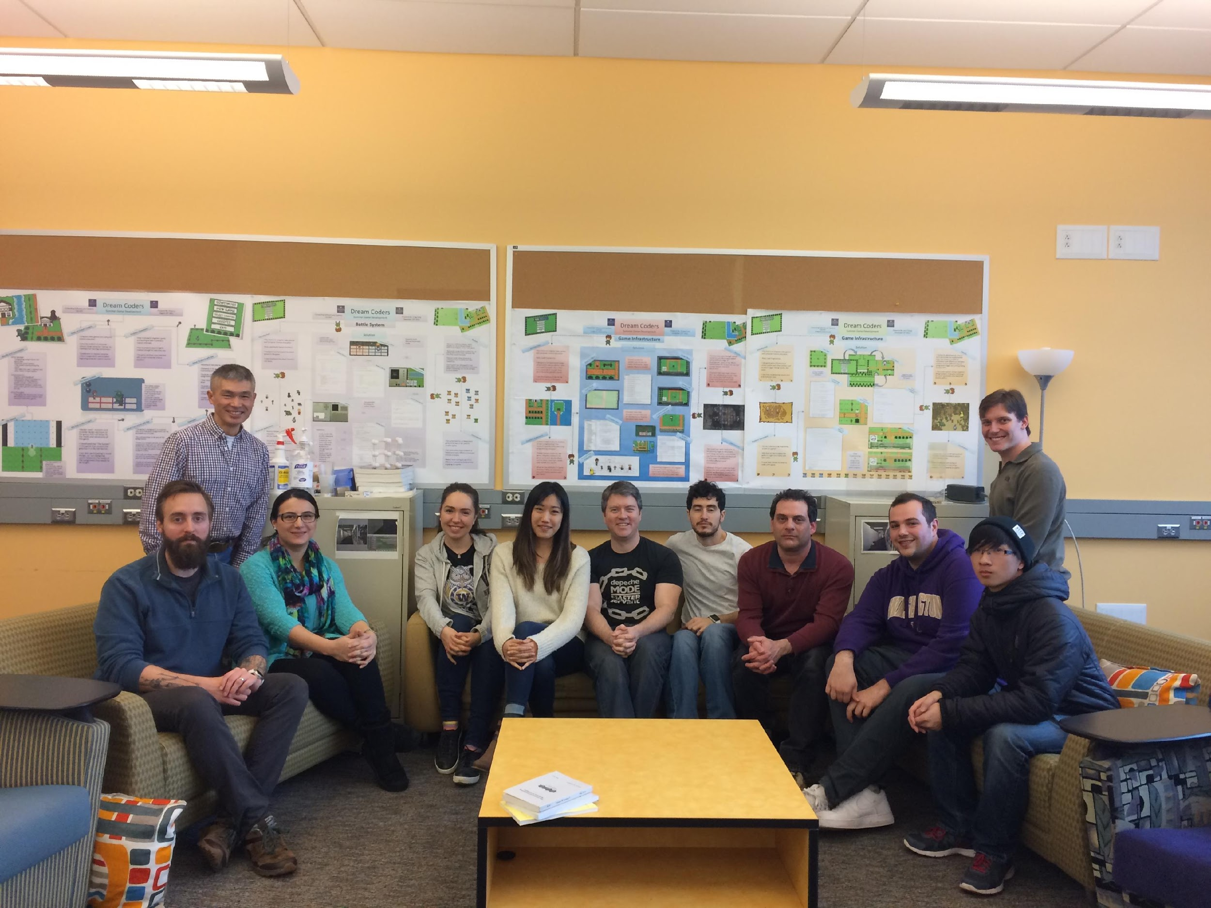
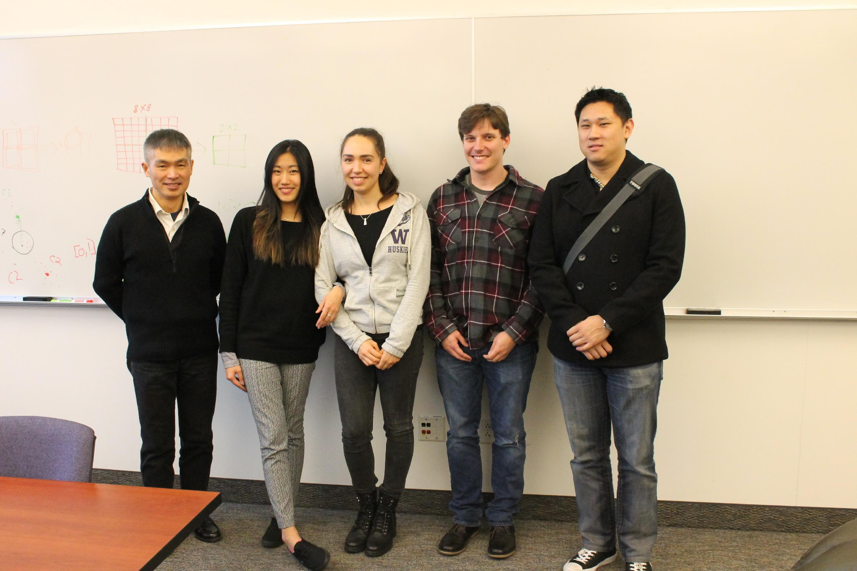
Questions?
Please check:
http://depts.washington.edu/dslab/
2017
2018

